Slide 1

Cervical Cancer Screening
Kirsty Hawke

Slide 2

Early Detection & Prevention
Zambia is ranked 3rd with rates of 66/100,000¹
One of the most preventable cancers²

Slide 3

Background
Cervical cancer is a disease in which cancerous cells form in the tissues of the cervix
Usually no obvious symptoms
Detection: regular check-ups

Slide 4
Data
Cervical cancer (Risk Factors) Dataset (source)
Collected in Venezuela in 2017
32 features from 858 patients
Demographic information
Habits
Medical information
Issues
Many missing values (max 787 responses)
Small dataset
Target
Biopsy result

Slide 5
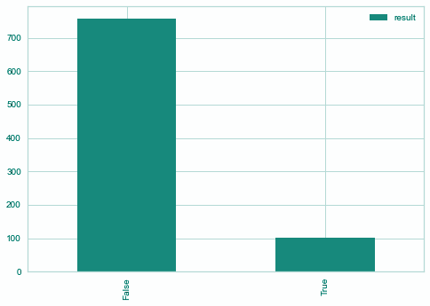
Data Exploration
Fig 1: Class Distribution of Cervical Cancer Diagnosis
Notes:
Upsampled to 50:50

Slide 6

Cleaning Methods
Resampling
Up-sampled positive class
Imputation
K Nearest Neighbour – for missing values
Scaling
RobustScaler - to reduce outlier effect

Slide 7
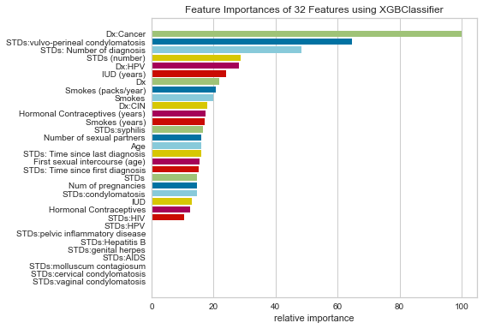
Feature Engineering - Feature Importance
Fig 2: Feature Importance

Slide 8
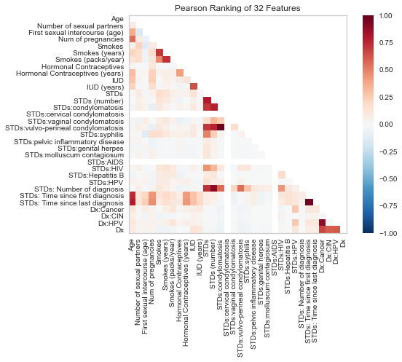
Feature Engineering
Fig 3: Pearson Ranking of Features

Slide 9
Age
Number of pregnancies
Smokes (packs/year)
Number of sexual partners
First sexual intercourse (age)
Hormonal Contraceptives (years)
IUD (years)
STDs (number)
Selected Features
Notes:
Considered ‘conservative’ features
Tried to reduce to 5 features but drastically reduced performance

Slide 10
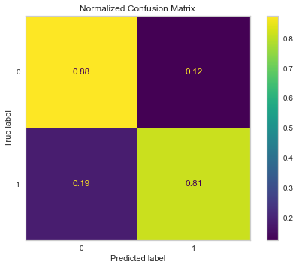
Model
XGBoost Model
eXtreme Gradient Boosting
Speed & performance
Baseline accuracy: 0.534
Baseline F1 Score: 0.23
F1 Score: 0.832
Accuracy: 0.93
Fig 4: Confusion Matrix
Notes:
The F1-score combines the precision and recall of a classifier into a single metric by taking their harmonic mean. It is primarily used to compare the performance of two classifiers.

Slide 11
Workflow
User Input
Model
Prediction
Data Preparation
Webapp Display

Slide 12
Demo

Slide 13

Improvements
Deploy webapp via Heroku
Bigger dataset
Include whether or not the patient is vaccinated for HPV
To reduce overfitting
Increased testing
More appealing user interface
Conduct pilot study to gather user feedback

Slide 14

Thank you!
https://github.com/hawkek

Slide 15
Tech Stack Used
Python
Streamlit
Jupyter Notebook

Slide 16
Citations
https://www.wcrf.org/dietandcancer/cervical-cancer-statistics/
https://www.kucancercenter.org/outreach/prevention/preventable-cancers
https://www.healthywomen.org/your-health/prevention--screenings/cervical-cancer-screening-save-life
Image
Improvement by Kukuh Wachyu Bias from NounProject.com

Slide 17
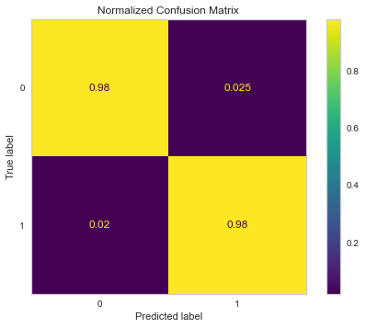
Overfit Model

